Slide 1
Keep your Projects Organised

Slide 2
Team Introduction
Matej Cambal
Bloomreach
Senior Business Consultant
matej.cambal@bloomreach.com
Gabrielle Couzin
Bloomreach
Customer Success Manager
Business Consultant for 6+ years, working in UK, WE, CEE
Emailing specialisation
CSM for 5+ years, working in UK and WE
Owner of Housekeeping initiative and Academy course

Slide 3
Overview
Intro & Quiz
Leverage the Data Manager features
Keep your work organised with initiatives
Proactively Manage Users rights
How do to a 1 time clean up?
Notes:
See you in Next video

Slide 4
Sli.do
Go to slido.com and enter #bestpractices2023
OR click on the link in the chat
OR scan the QR code
Quiz starting soon
Q&A Session – ask questions during the session, will be answered at the end of the session

Slide 5
Leverage the features of the Data Manager

Slide 6
Add groups, descriptions and example value
Flag fields as PII
Set up Expiration Rules

Slide 7
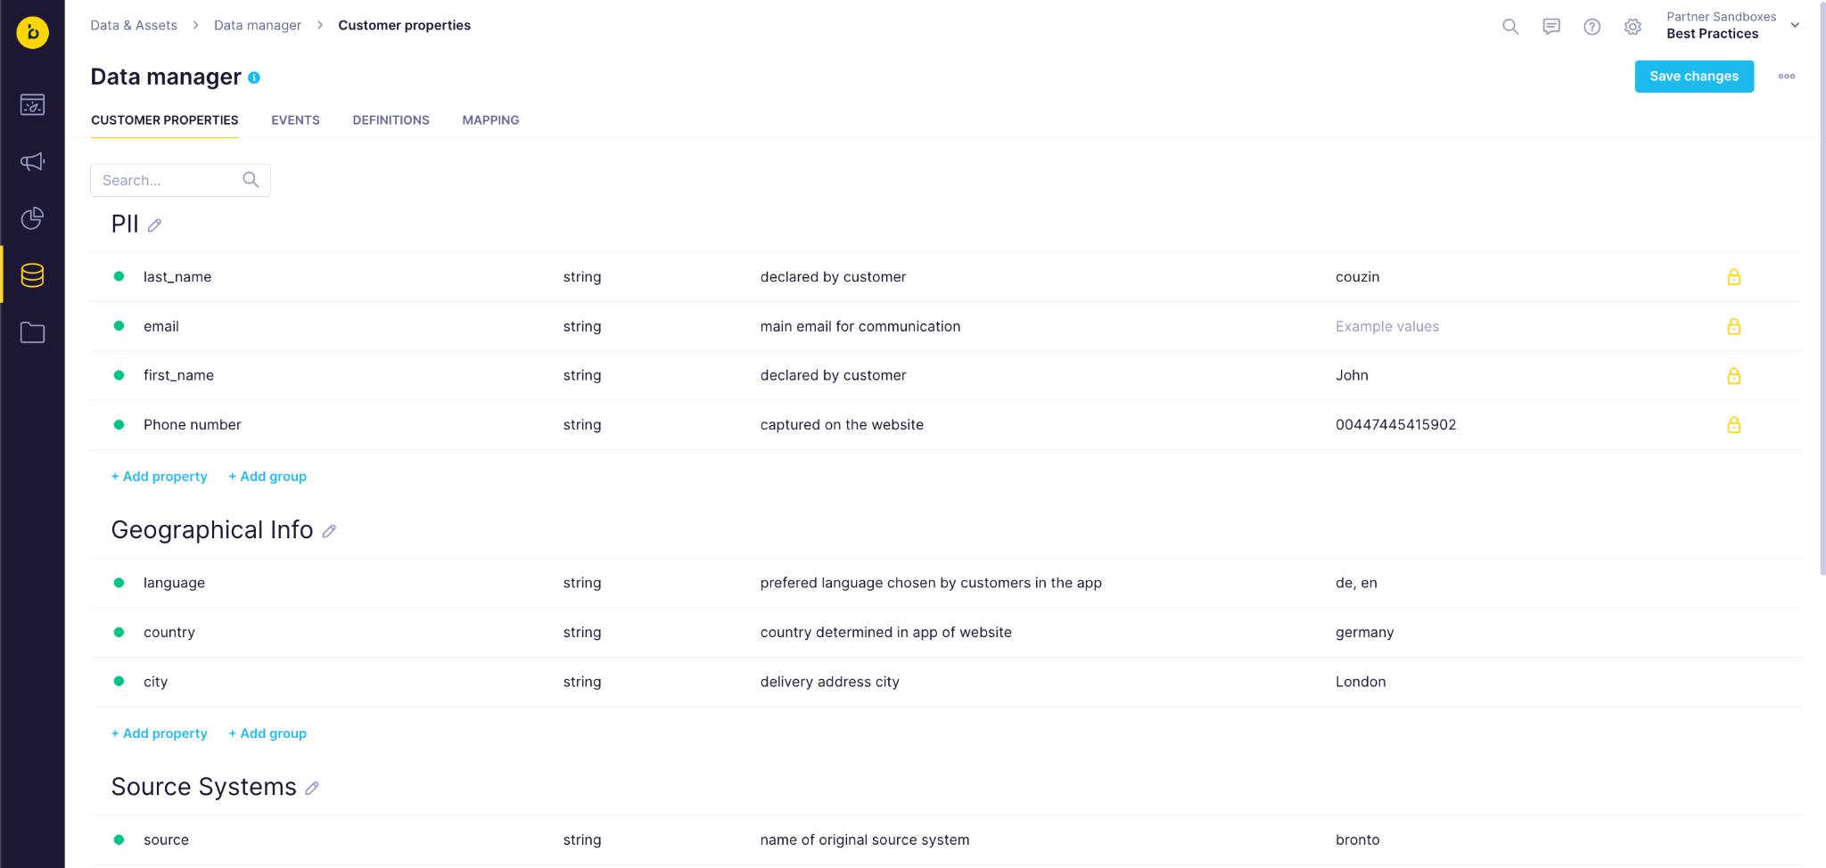
Notes:
Customer Profiles:
Contact Details
Demographics
Email Engagement Properties
Declared Preferences
Scenario Created Properties
Events
Website & App Behavior
Purchase related
Customer Service
Scenario Created Events

Slide 8
Fill in Descriptions and Examples
in the Data Manager
Fill in description - the description in the tracking document can be copied & pasted here
Fill in example values - click on show tracked values to see a few examples easily
Notes:
Forgot to mention the tracked value

Slide 9
Lock PII fields in the Data Manager
Once a property is marked as PII its values will only be visible for users who have the “Personal Data Viewer” right assigned
Click on the lock to mark a property as PII

Slide 10
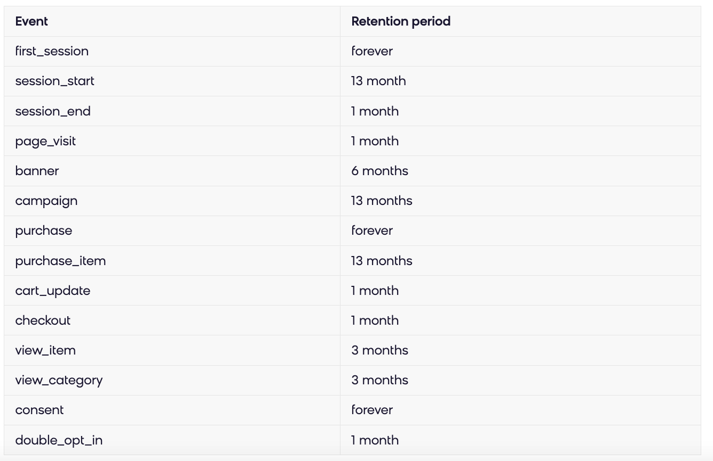
Event Expirations - Recommended Retention Period
Offers from our best category
Check our documentation page

Slide 11
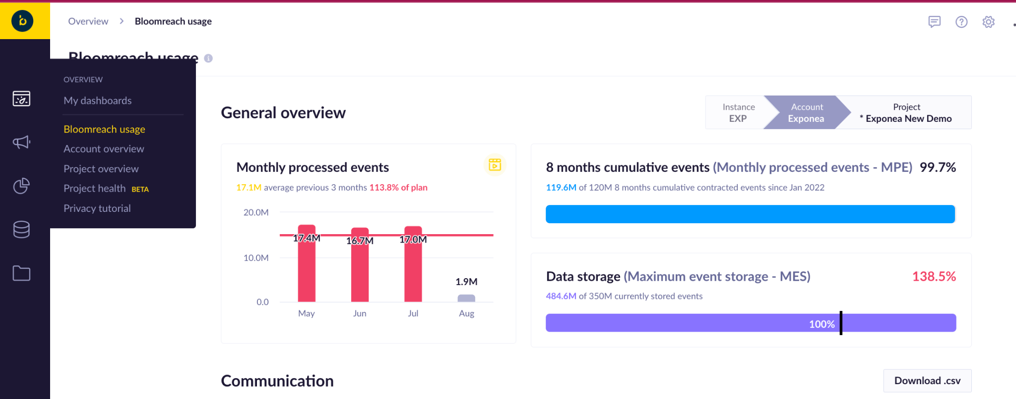
Event Expirations - Check Your Usage Dashboard
Offers from our best category
Verify if you are within the limit of your contractual agreement on MPE and MES

Slide 12
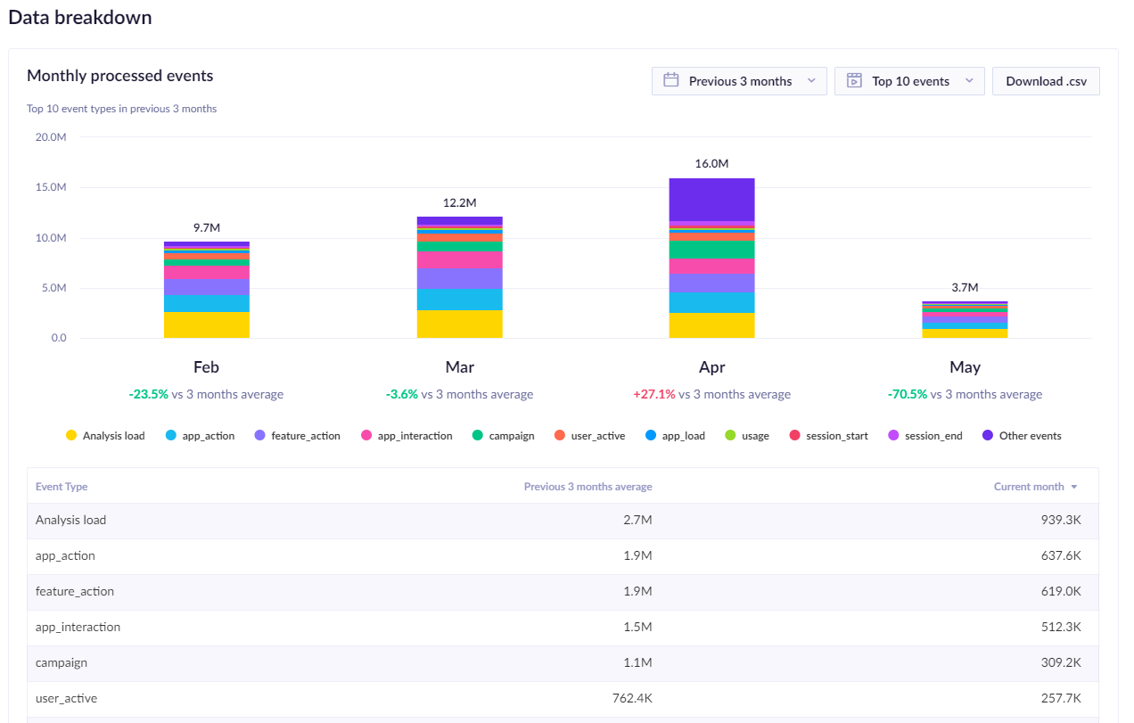
Event Expirations - Check Your Usage Dashboard
Offers from our best category

Slide 13
Keep your work organized: use initiatives

Slide 14
What is an initiative?
Initiatives work as folders. Every analysis, campaign, metric, or definition can be a part of an initiative.
Each component can belong to only one initiative or be outside of initiatives
Component of an initiative will only be available when working within the same initiative.
Initiatives are the only vehicle for cloning across projects
What about tags?
Tags are mostly useful for searching and adding context - Each component can have several tags.

Slide 15
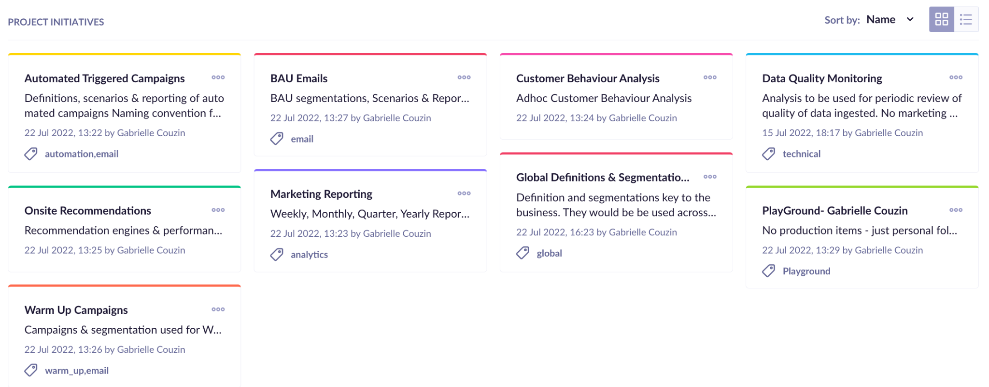
Example of key Initiatives

Slide 16
How to keep organized easily
Start in an initiative
Go to the analytics or campaign you want to create
Start creating it and if you need to use a definition check if:
A - it already exists: then just use it
B - it does not exists
If you need to define a running aggregate or aggregate do it on the fly
If you need to create an expression or a segmentation then open a new window and create it
Remember to test your complex definitions before you use it

Slide 17
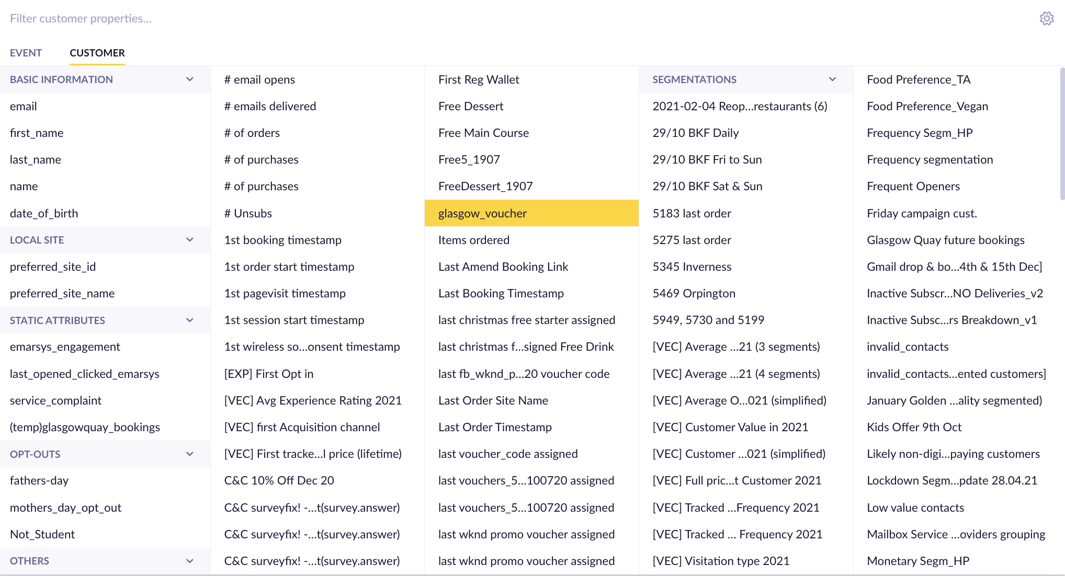
Key things to remember about initiatives
Components stored outside of initiatives will be visible in every filters throughout the product (analysis, campaigns etc)
As you use the product more it will create a very confusing & error prone display - this is the number 1 complain of end users past 6 months using the product

Slide 18
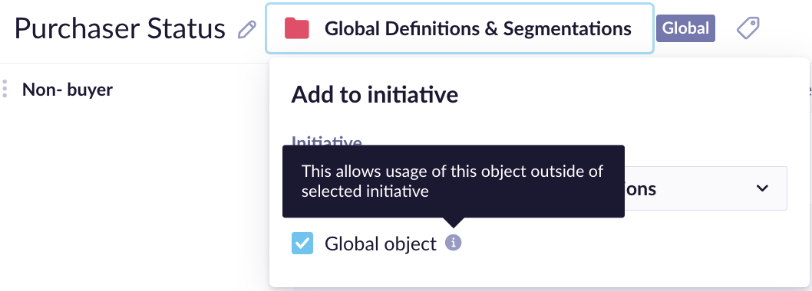
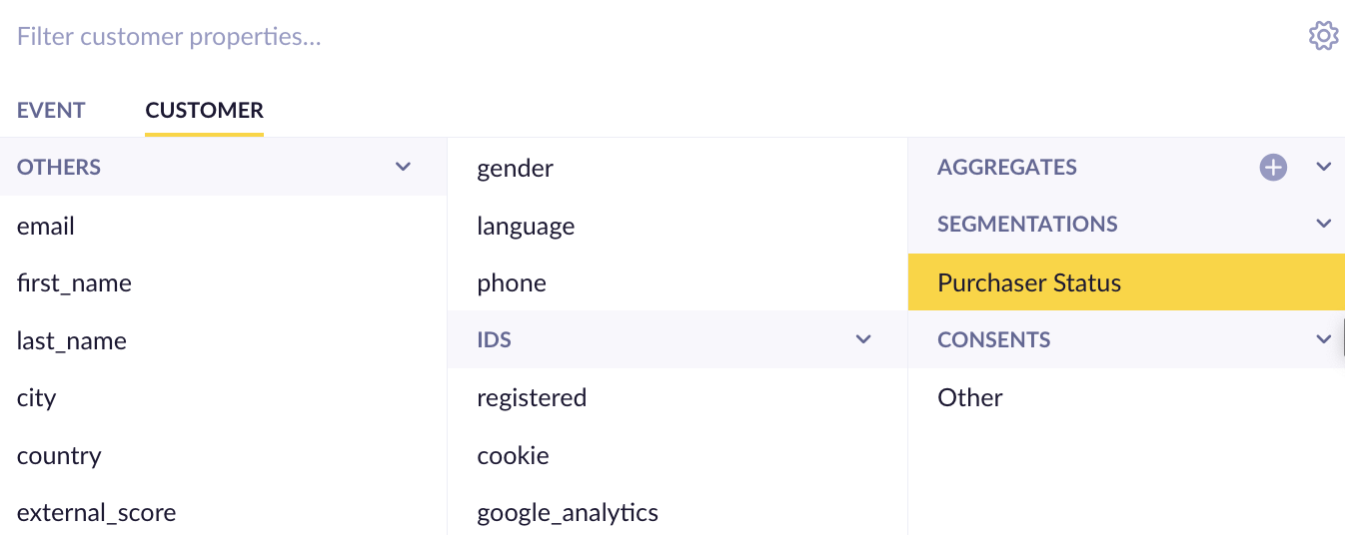
What is a global object?
Every objects, definition, scenarios, assets etc. created in Engagement can be marked as global by selecting it in the add to initiative section
Once marked as global the component can be used across all initiatives
Global components will be visible in the filter list throughout the application

Slide 19
Proactively Manage Access Rights

Slide 20
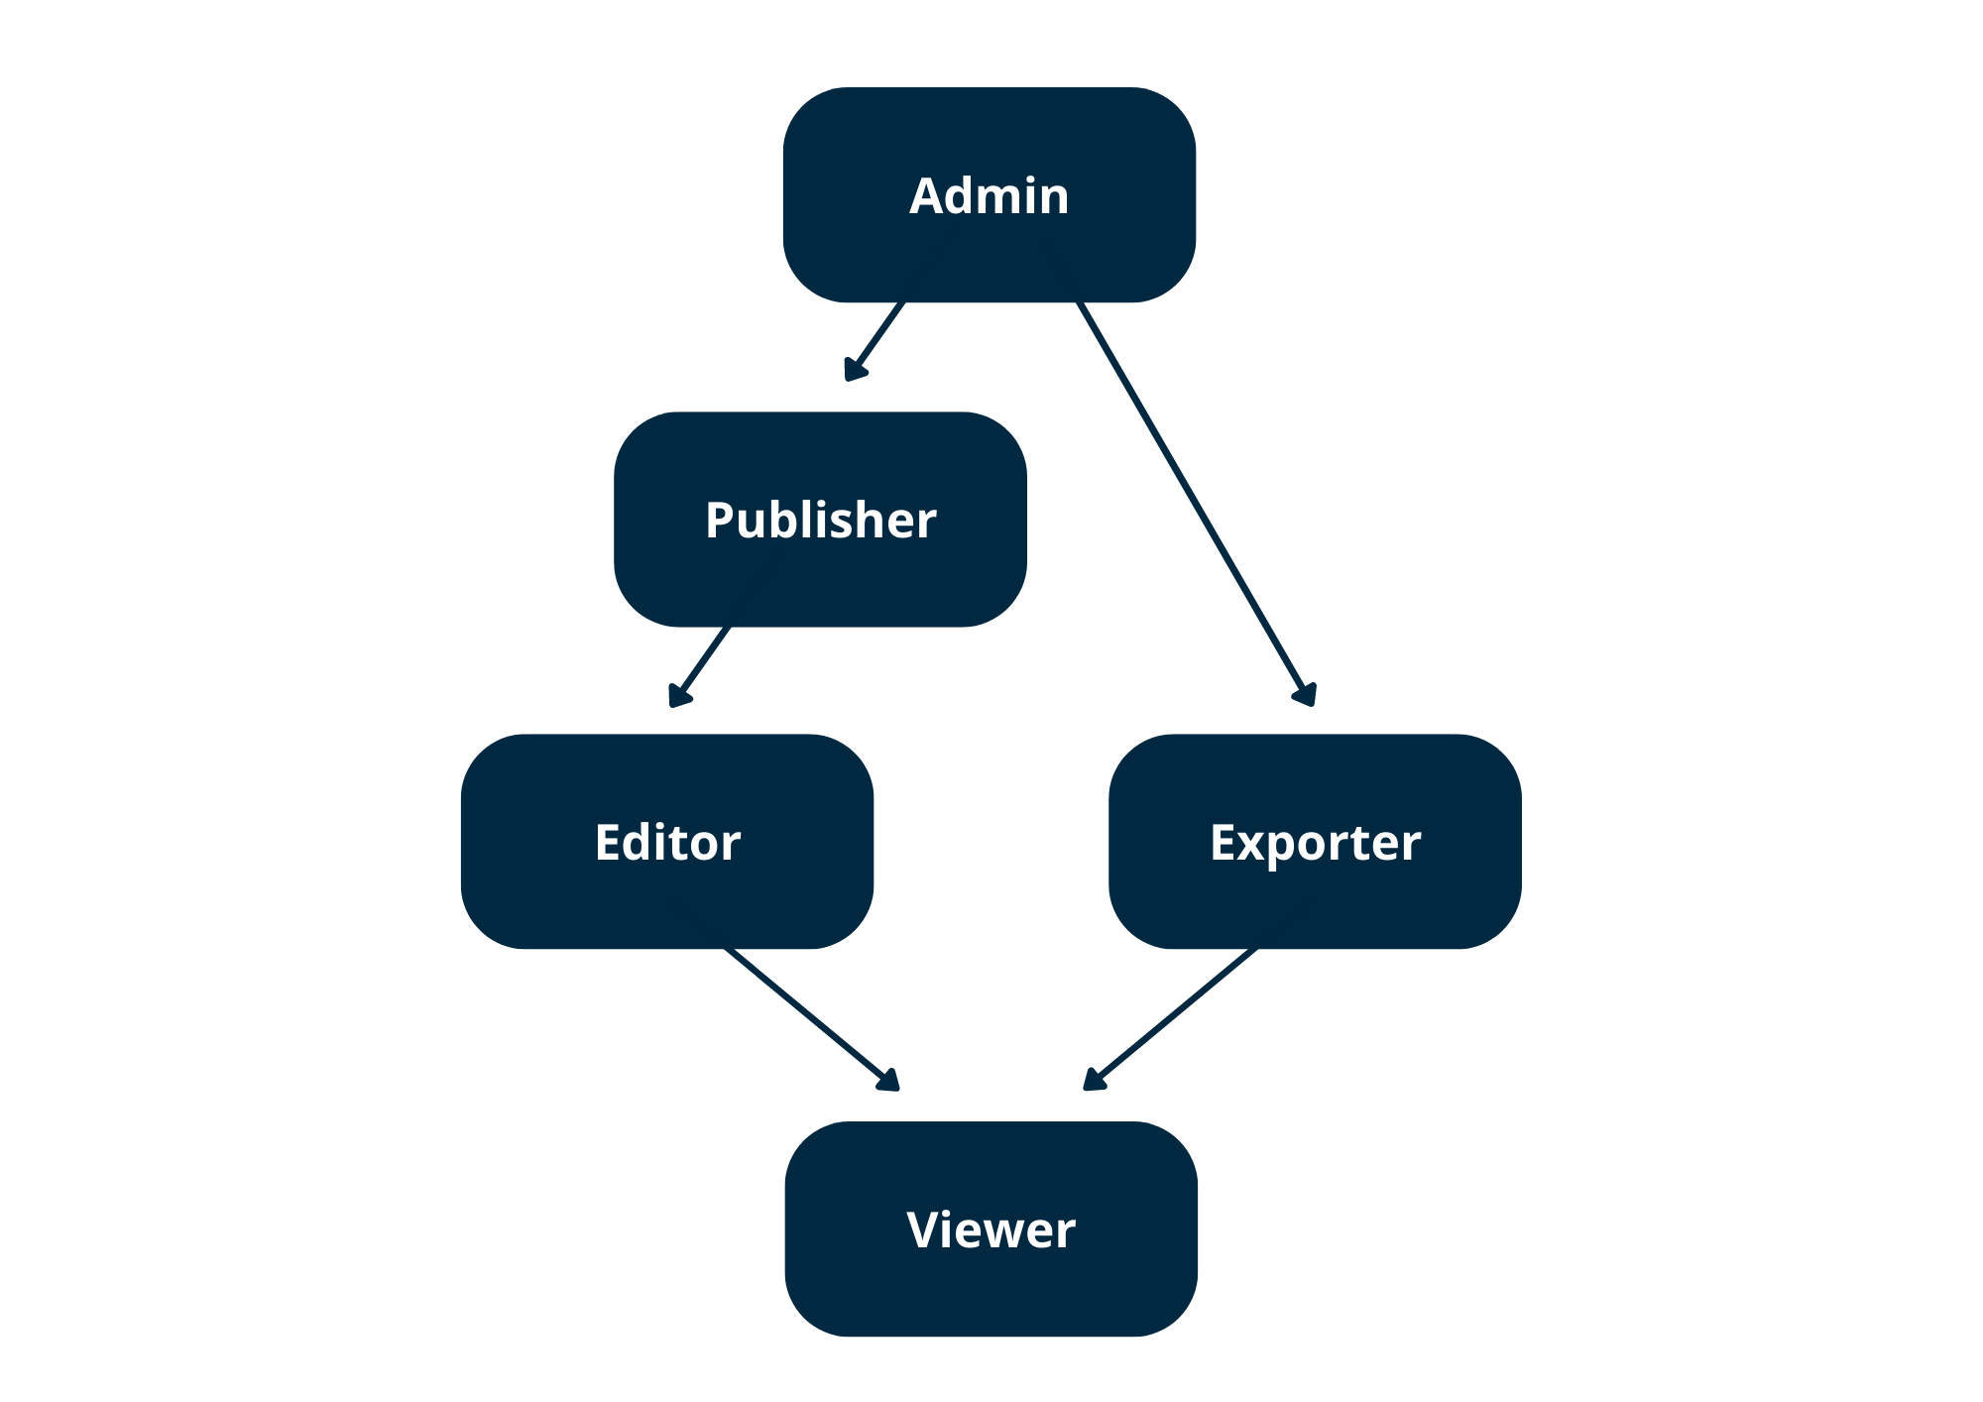
Understand Roles Structure in Bloomreach Engagement
Areas roles are being applied to:
Analysis
Campaigns
Email Campaigns
Experiment
Weblayer
Scenario
In app Messages
Survey
Customer
Data Manager
Export
Import
Endpoints
Project
Higher-level roles inherit all permissions from lower ones and lower levels never allow functions from higher-level roles.
The first word or two represents the section of the application, and the later the extent of the permission

Slide 21
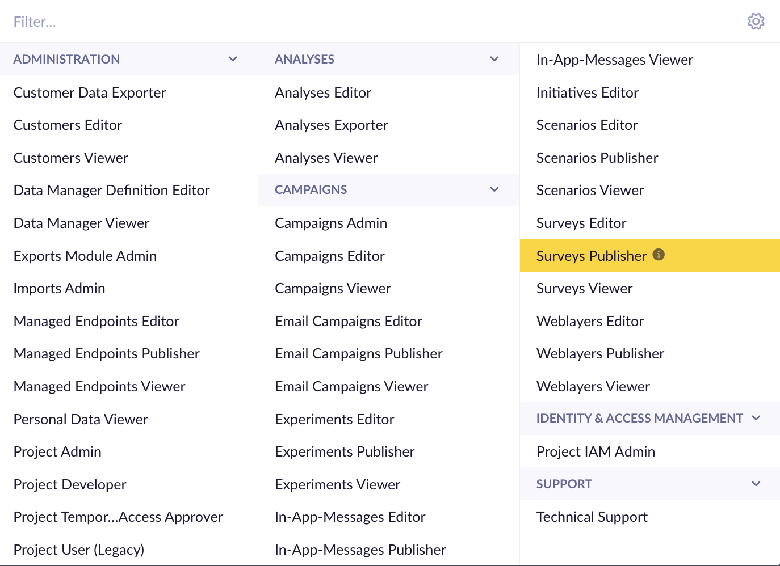
Roles Available in Bloomreach Engagement
Special Rights
Personal Data Viewer
Project IAM Admin
Project Temporary Access Approver
Technical Support
Initiative Editors
The first word or two represents the section of the application, and the later the extent of the permission

Slide 22
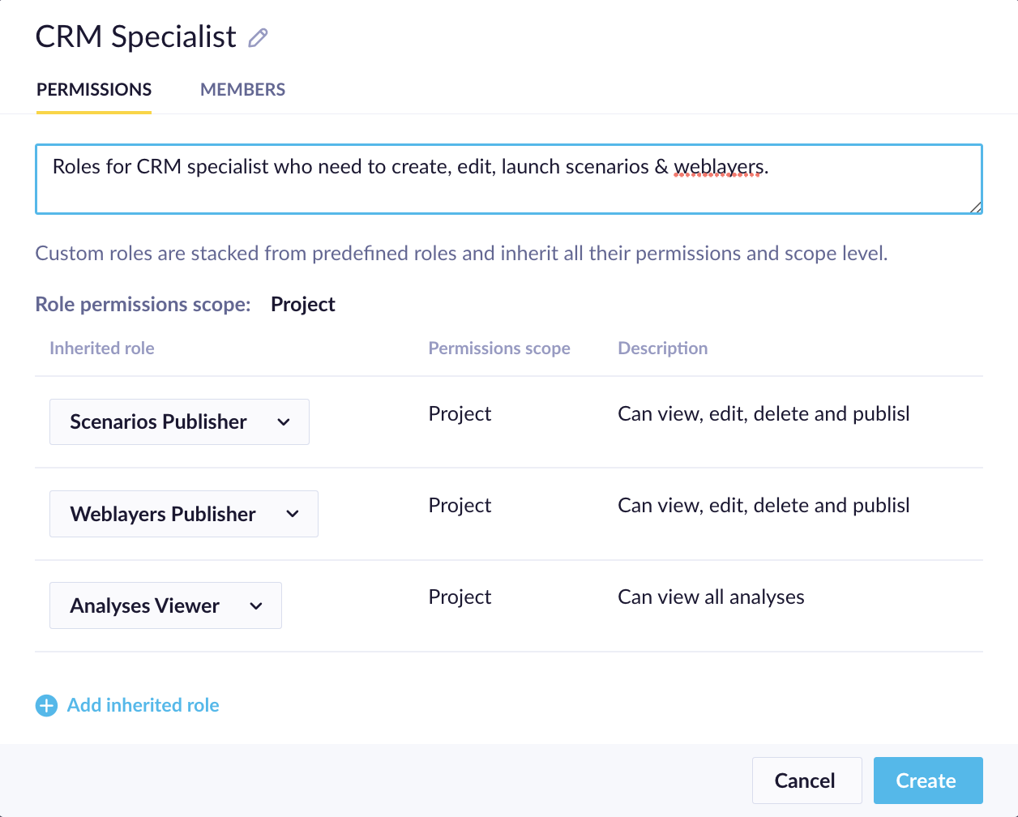
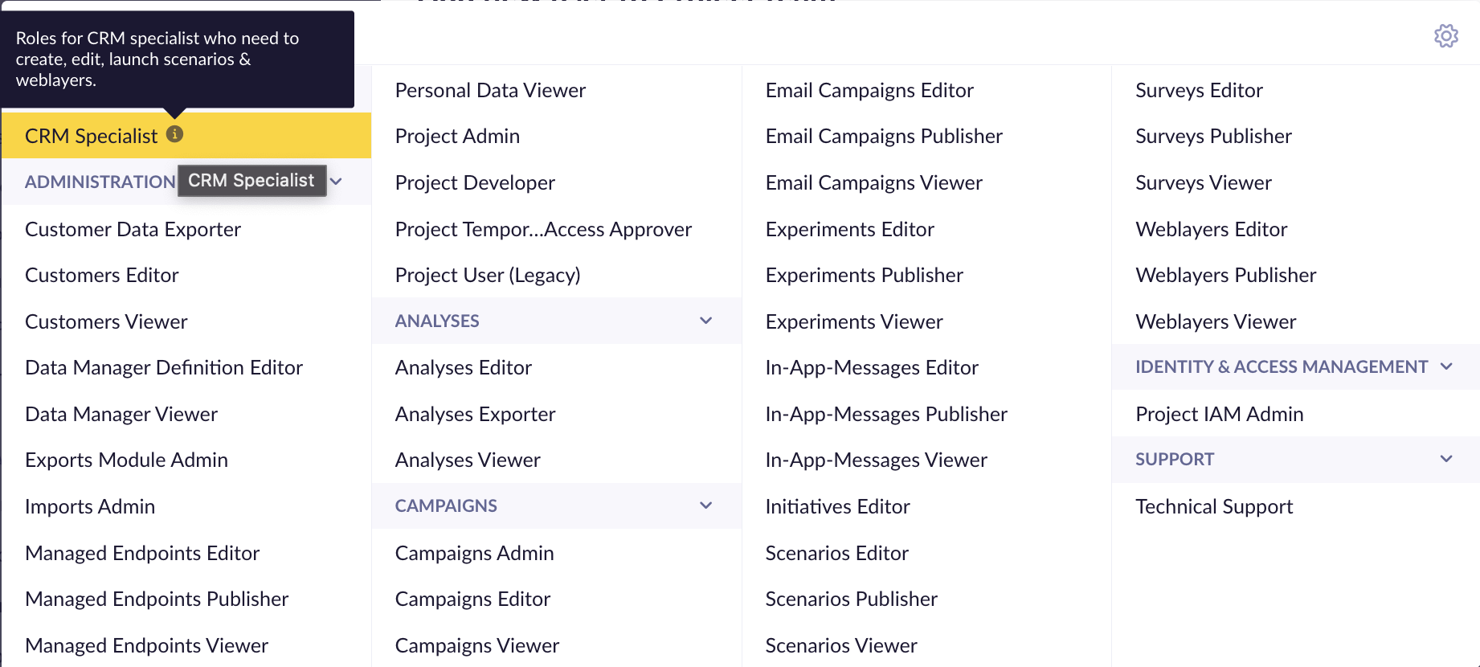
Define Custom Roles to Match your Teams’ Responsibilities

Slide 23
Nominate an Access “Gate Keeper”
FOR IN APP ACCESS
The team best trained to managed access to your customer database is typically your IT operation team.
They tend to be the best team at remembering to remove rights to employees when they leave!
A senior manager or product owner could also have the right to grant access to avoid bottleneck or grant access to consultants for instance
FOR EBQ ACCESS
Define the persons allowed to authorize & revoke access to EBQ and flag them to your CSM
EBQ access can only be granted by your CSM via written requests
According to your internal process & chosen method of access control create a 1 pager user guide on how to get access for the first time or if you have trouble logging back in whom to reach out internally.

Slide 24
How to do a 1 time clean up?

Slide 25
Identify Campaign & Analytics that matter
Delete & Archive the clutter
Set yourself for cleanliness in the future

Slide 26
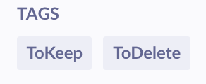
Step 1: Identify Campaigns, Analysis & Assets
Identify Campaigns & Analysis to Keep:
Ask each user to tag the campaign, dashboards, analysis and assets that they use on a repeat basis as
For campaigns you can use the calendar to see what is scheduled on a recurrent basis. Or scenario history to see when campaign stopped running
For all other - the last time edited can help
Users can also use the filter
Communicate in your organization that all elements not identified as ToKeep will be deleted at X date.
Don’t forget to communicate as well to your CSM, consultants, internal teams receiving imports and teams in charge of integrations.

Slide 27
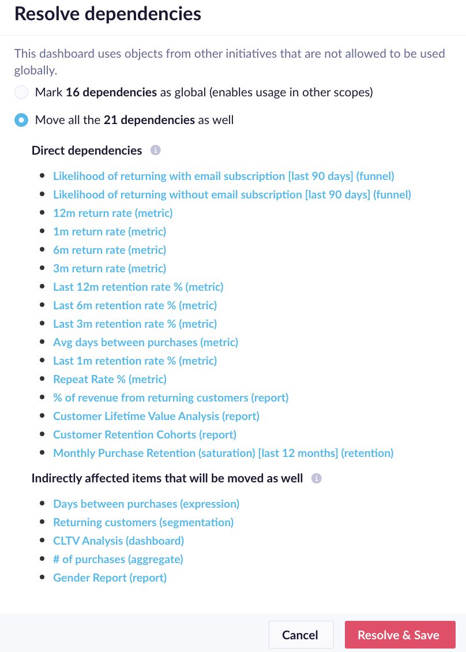
Step 2: Delete Campaigns, Analysis & Assets
Items not flagged as ToKeep:
Delete campaign, dashboard, analysis - if in doubt - archive them first
Items flagged as ToKeep:
Save them into initiatives (create them as needed)
If it has dependencies select Moving dependencies preferably - Review the Indirectly affected items section

Slide 28
Step 3: Organize Aggregates, Expressions, Segmentations
Create a Global Definition & Segmentation Initiative
Review the list of Definitions & Segmentation without initiatives or global & place the ones that should be global into the initiative created above & mark them as global
Go to section 3 to learn more about global components

Slide 29
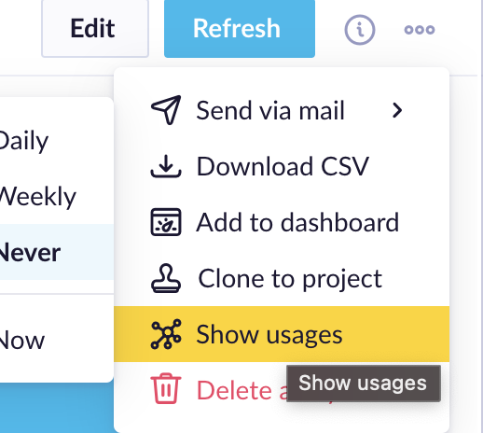
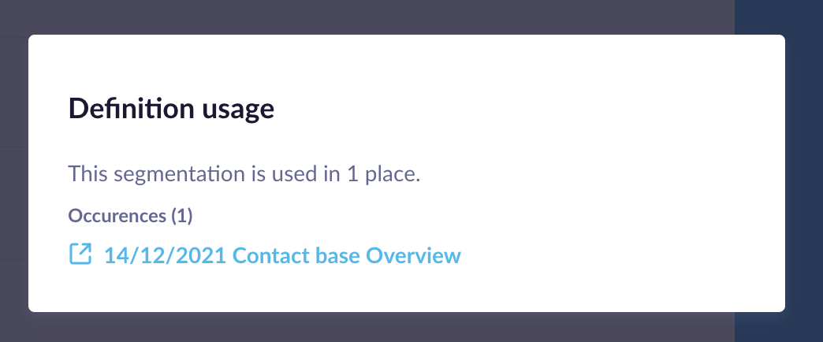
Step 4: Delete Aggregates, Expressions, Segmentations
For all others review their usage:
If not used delete them
if used then keep it, adjust their global status & save into a relevant initiative

Slide 30
Monthly Clean Up Checklist
Review Global Objects & Initiatives Usage
Archive & Delete older objects
Review User Lists
Document New Data Elements
Review your Product Usage

Slide 31
Few extra tips from projects

Slide 32
Extra tips based on common findings
Prepare your team for manual data imports - when you need to import a list of customers to be targeted, do not use a new customer property (with e.g. campaign or segment name name as property name) every time - but create a few properties used for this purpose
Be consistent in the upper/lower case usage - property names are case sensitive and create duplicates
Build (simple) documentation - document where are the data coming from, how are they imported, who can investigate issues - helps with long term maintenance and avoiding bad data quality
Use naming conventions and separate automated from bulk campaigns - helps with long-term analytics later

Slide 33
Need help or more knowledge?

Slide 34
Academy and Consulting
On-demand Academy Housekeeping course with more details about keeping your projects clean
6 lessons + final quiz
Bespoke consulting package - Audit as a service - please reach out to your CSM
Identify data issues
Get back control of your data
Improving time to value
Controlling the cost
Data Fixing - one off cleanups
https://academy.bloomreach.com/engagement-housekeeping-best-practices

Slide 35
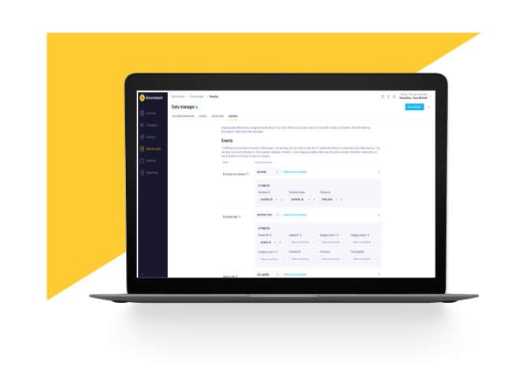
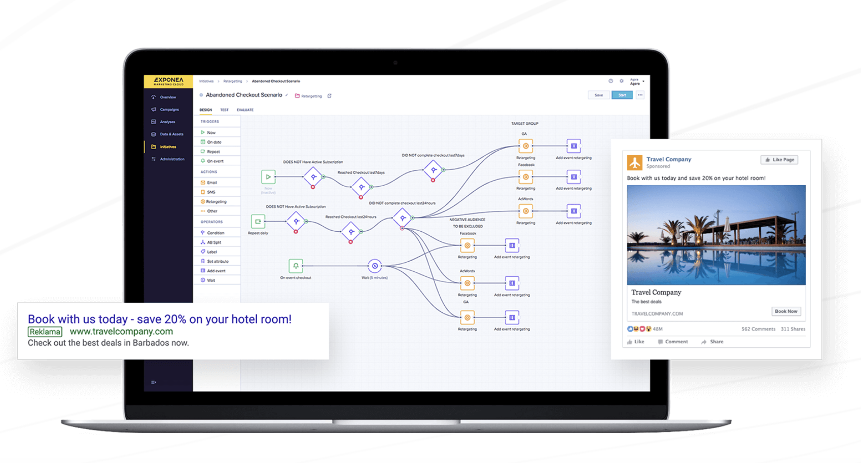
Audit as a Service
A service to enable clients to efficiently manage their projects and help them activate data to drive value and business efficiency.
OVERVIEW
Project hygiene and maintenance is one of the more complex challenges for our customers to solve. This is generally due to lack of knowledge of the data and lack of resources to maintain correct hygiene. These challenges can lead to commercial, business, and compliance risks.
KEY BENEFITS
Project health overview
We work to create a general overview of the health of your project and compare it to similar clients.
Identify data issues
We will identify data issues by running a full data audit on your project.
Get back control of your data
We will update or create a full tracking document so that you and your team are aware of all data coming into the project, and can activate it more efficiently.
Improving time to value We will ensure that project data mapping is correctly configured to enable full customer profile overview history and ensure new P&P scenarios drive value from the moment they’re launched.
Controlling the cost We will work with you to review and implement recommended data expiration metrics and event usage.
Data Fixing We will create one-off system scenarios to fix the most common data issues, such as attribute duplication.
Time to implement: 1-4 weeks*
Time to results: 1-3 weeks**
Basic Package: 20 MH
Intermediate Package: 40 MH
Advanced Package: Custom
*Dependant on what level of audit is done
**Dependent on which recommendations are actioned

Slide 36
Q&A and final notes
Go to slido.com and enter #bestpractices2023
OR click on the link in the chat
OR scan the QR code
Ask any questions!
Please give us feedback in the poll
Next session in March - Plug & Play use cases Library

Slide 37
Happy Clean Up!

